Slide 1

Section 7.1 Integration by Parts
Lecture 1
Reversing the Product Rule

Slide 2

Section 7.1 Homework Submission to Canvas
Preview of section
Skim the section in text and write a short paragraph summary.
Give a bulleted list of all important definitions, theorems, and formulas without details.
Notes on video lectures
Take notes on everything written on slides including all details, worked examples, on-own activities, as well as your own thoughts and questions.
Try on-own activities first, then write down provided solution next to it for comparison.
Worked examples from the text
Write down the problem and attempt without looking at the solution.
Use the solution to write the best explanation you can.
Solutions to textbook exercises
Model approaches and explanations given in the video lectures and textbook examples.
Final reflection of section
List the key takeaways to remember as a bulleted list.

Slide 3
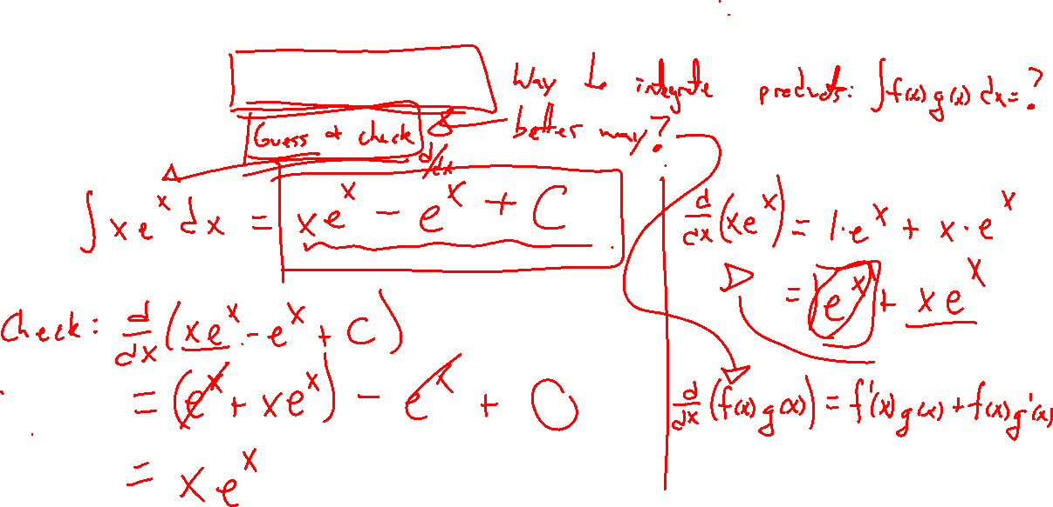
Example: Try On Own
Notes:
How to integrate a product?
Ex: \int x e^x ~dx
Guess and check not really a good idea, need a technique.

Slide 4
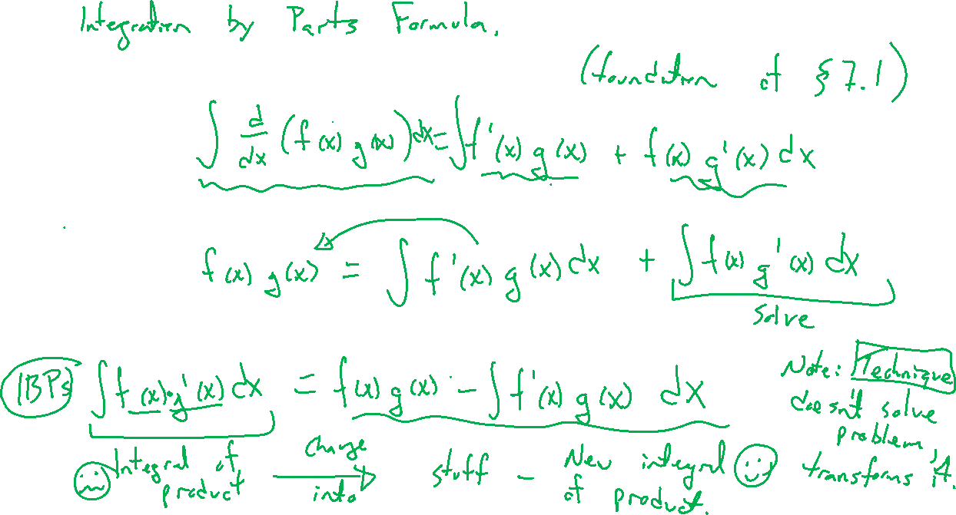
Reversing the Product Rule
Notes:
End formula called integration by parts

Slide 5
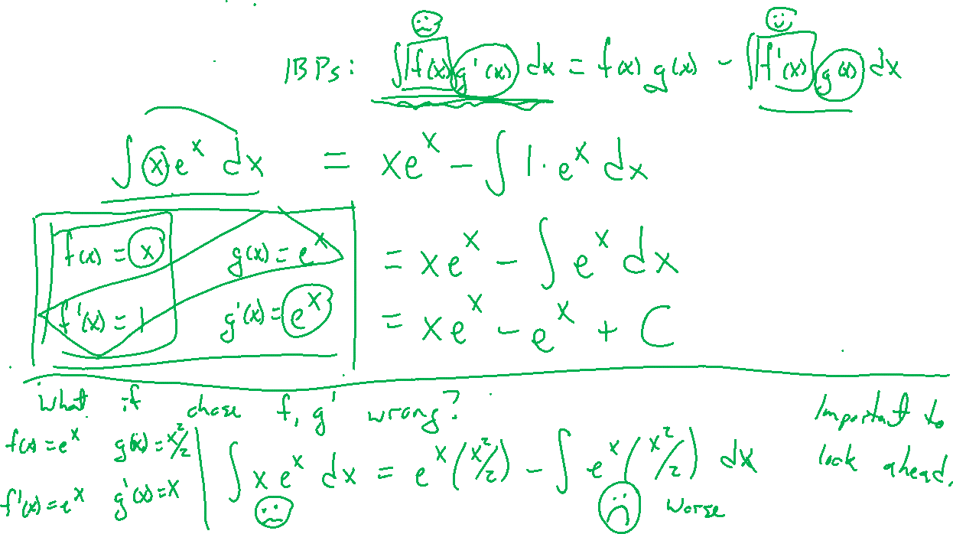
Example:
Notes:
Revisit previous example: \int xe^x dx
Need to choose f and g', write out carefully.
What if we chose wrong? Results gets more complicated rather than easier.

Slide 6
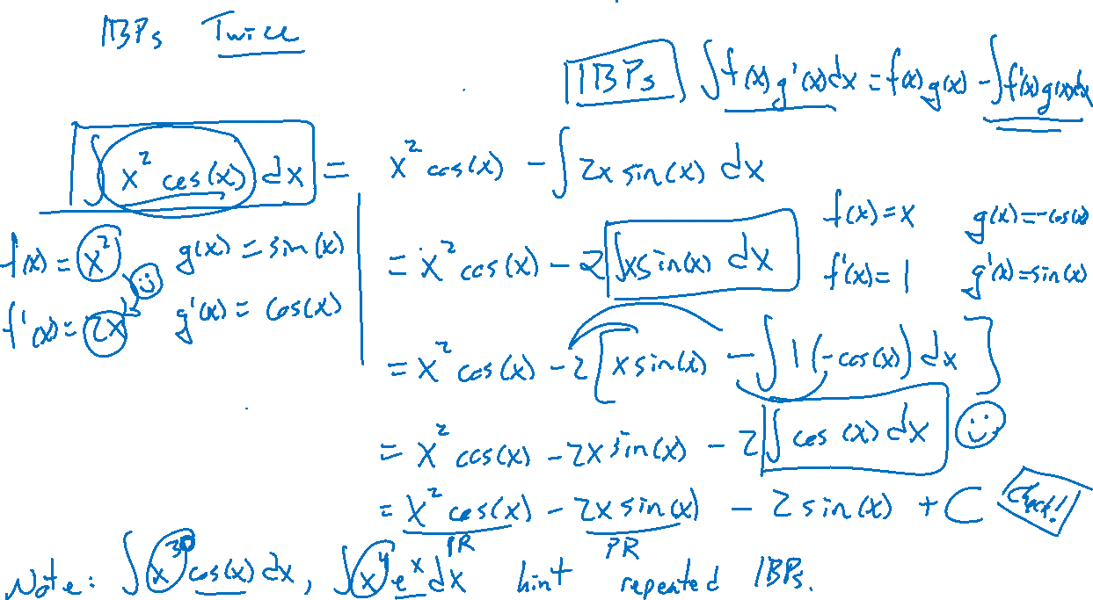
Example: Try On Own
Notes:
\int x^2 cos(x) ~dx
Ask to check on own
Note, x^3, x^4, all same idea so long as can keep integrating g'(x)

Slide 7
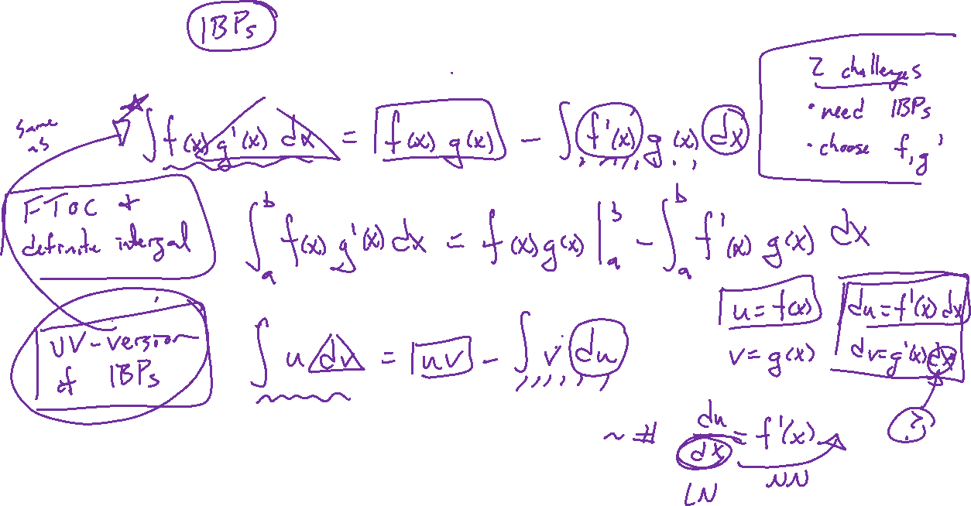
Integration by Parts Summary
Notes:
f(x), g'(x) formula.
Note, FTOC allows for a definite integral version
u dv formula, will stick to prior since more intuitive
Show example for u dv with \int xe^x dx
Note: IBPs is a technique rather than a formula since it doesn't finish the problem, just (hopefully) simplifies it.

